Slide 1

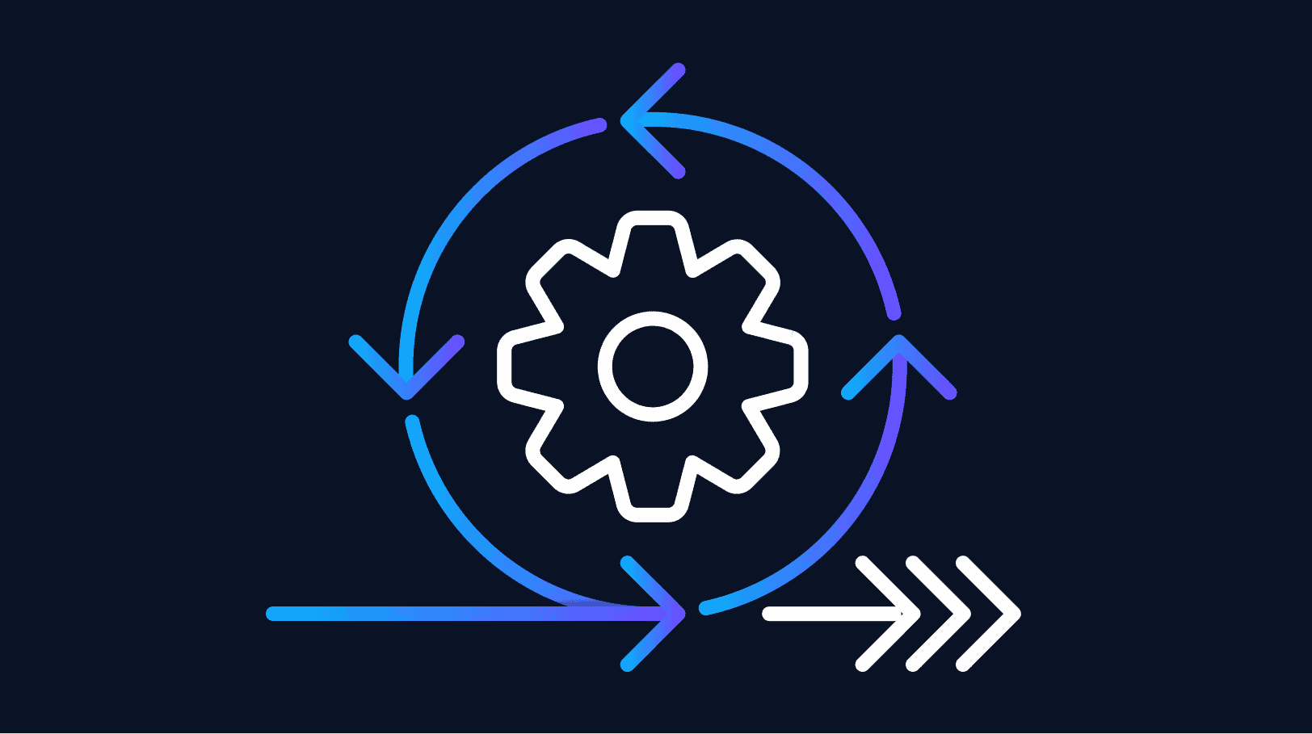
V MODEL & AGILE MODEL
BY
BUG SQUASHERS

Slide 2
V-MODEL IN SOFTWARE TESTING
The V-Model is a software development and testing methodology that is based on the concept of a V-shape. The V-model is a variation of the traditional waterfall model and emphasizes the importance of testing parallelly throughout the corresponding stage of the software development life cycle (SDLC) i.e. Requirement Analysis, Design, Implementation, Testing, Deployment and Maintenance.
The V-Model consists of two main parts:
1.the development phase and
2.the testing phase.
Each level of the development phase has a corresponding level of the testing phase, and each level builds on the previous level.

Slide 3
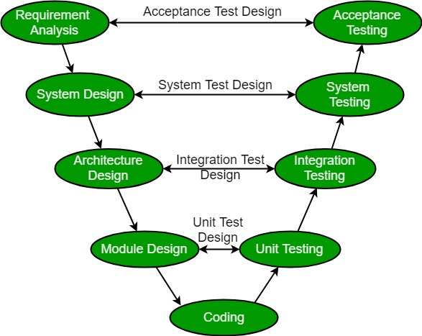
PHASES OF V-MODEL

Slide 4
PRINCIPLES OF V-MODEL
Testing is an integral part of the SDLC: The V-Model emphasizes testing at every stage of the software development process. Testing is not an afterthought or an optional activity but an integral part of the SDLC.
Testing starts early: Testing starts early in the SDLC, beginning with the requirements analysis phase. The earlier defects are found, the easier and less expensive they are to fix.
Defect prevention: The V-Model emphasizes defect prevention by ensuring that requirements are clear, complete, and consistent, and that design documents are accurate and complete. This helps to prevent defects from entering the system in the first place.
Verification and validation: The V-Model emphasizes the importance of both verification and validation. Verification ensures that the software meets the requirements and specifications, while validation ensures that the software meets the needs of the users or customers.

Slide 5
USES OF V-MODEL
When the requirement is well defined and not ambiguous.
The V-shaped model should be used for small to medium-sized projects where requirements are clearly defined and fixed.
The V-shaped model should be chosen when sample technical resources are available with essential technical expertise.

Slide 6
PROS & CONS
Early detection of defects.
Emphasizes quality.
Improved traceability.
Integration of testing.
Predictable and well-defined process.
Rigidity.
Documentation-heavy.
Limited applicability.
Dependence on testing.
Limited scope for creativity.

Slide 7
CONCLUSION OF V-MODEL
The V-Model is useful for software development and testing that emphasizes testing throughout the SDLC. Each phase of the V-Model builds on the previous phase, and each phase is linked to a corresponding level of the testing phase. By following the V-Model, software development teams can ensure that the software meets the requirements and specifications, is thoroughly tested, and is well-maintained throughout its life cycle.

Slide 8
AGILE MODEL IN SOFTWARE TESTING
The meaning of Agile is swift or versatile or adaptable.
Agile is based on the adaptive software development methods, whereas the traditional SDLC models like the waterfall model is based on a predictive approach.
The project scope and requirements are laid down at the beginning of the development process.
Agile methods break tasks into smaller iterations or time boxes to deliver specific features for a release.
Each iteration involves a team working through a full software development life cycle including planning, requirements analysis, design, coding, and testing before a working product is demonstrated to the client.

Slide 9
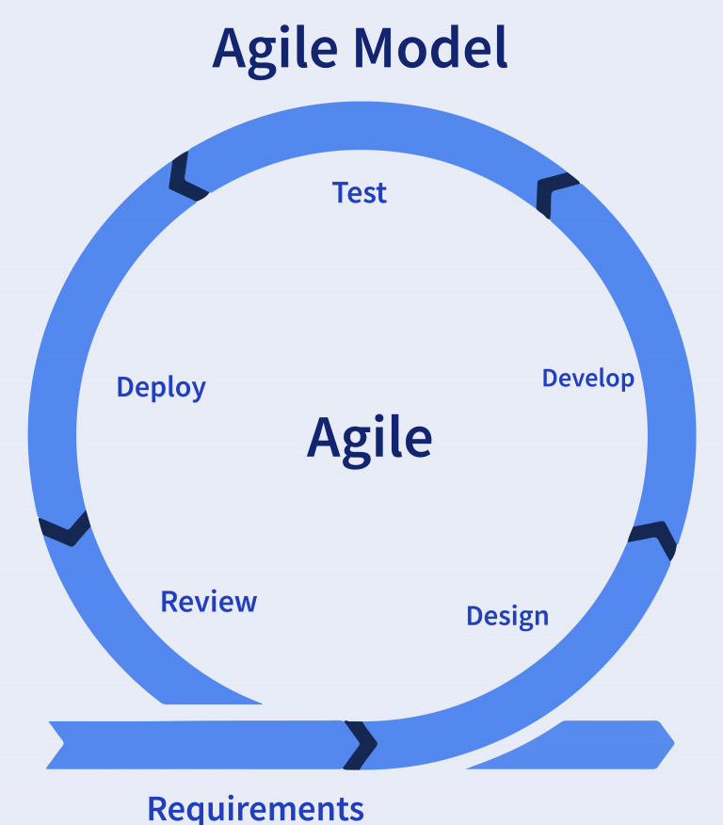
AGILE MODEL
Both development and testing operations are simultaneous under the Agile model of software testing.

Slide 10
Phases of Agile Method
Requirements gathering - project’s business opportunities, estimation of the time & effort required and assess technical and economic feasibility.
Design the requirements - demonstrate using use a user flow diagram or a high-level UML diagram (Unified Modeling Language)
Construction/Development - break tasks into smaller iterations or time boxes.
Testing - by the Quality Assurance team.
Deployment - in the user’s work environment
Feedback - receives feedback on the product and works through it.

Slide 11
ADVANTAGES OF AGILE MODEL
Demo over Documentation − Demo working software is considered the best means of communication with the customers to understand their requirements, instead of just depending on documentation.
Customer collaboration − As the requirements cannot be gathered completely in the beginning of the project due to various factors, continuous customer interaction is very important to get proper product requirements.
Responding to change − Agile Development is focused on quick responses to change and continuous development. Good model for environments that change steadily.
Delivers early partial working solutions.
Enables concurrent development and delivery within an overall planned context.
Easy to manage.
Gives flexibility to developers.

Slide 12
LIMITATIONS OF AGILE MODEL
Not suitable for handling complex dependencies.
Depends heavily on customer interaction, so if customer is not clear, team can be driven in the wrong direction.
There is a very high individual dependency, since there is minimum documentation generated.
Transfer of technology to new team members may be quite challenging due to lack of documentation.

Slide 13
CONCLUSION OF AGILE MODEL
In conclusion, the Agile Model provides organizations with a framework to thrive in an ever-changing business landscape. By embracing the principles of flexibility, adaptability, transparency, and collaboration, organizations can deliver value to stakeholders while fostering a culture of continuous improvement. Looking ahead, we can expect further advancements in Agile methodologies and the integration of Agile with other frameworks, paving the way for even more effective and efficient ways of working.

Slide 14
BUG SQUASHERS
Amisha
Guna
Hariharan
Sripadh
Sudhakar

